Slide 1
Assignment-2: Chunking
Group 14:
Yash Jain, 170050055
Aditya Sharma, 170050043
Debabrata Mandal, 170050073

Slide 2
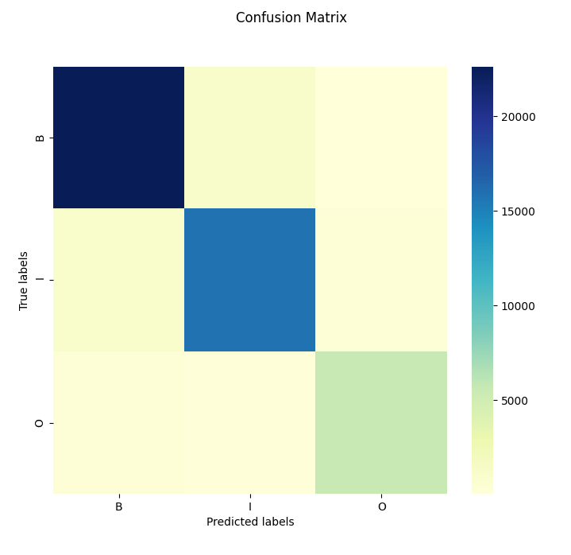
MEMM
15 Iterations of Maxent Classifier
 | Precision | Recall | F-score
Overall | 93.25% | 93.25% | 0.9325
B Tag | 94.00% | 94.86% | 0.9443
I Tag | 92.27% | 91.75% | 0.9201
O Tag | 93.40% | 91.26% | 0.9217
It is unnecessary to use Viterbi and Maxent classifier for O tags with punctuations like [, . “ ‘]. Therefore we add a rule to directly tag these as O
Accuracy jumps to 93.71%
O tag | 97.94% | 90.06% | 0.9383

Slide 3
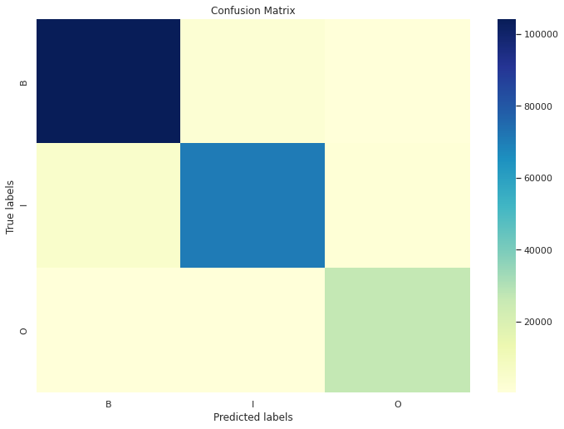
BiLSTM
15 epochs of BiLSTMNet
 | Precision | Recall | F-score
Overall | 95% | 95% | 0.95
B Tag | 95% | 97% | 0.96
I Tag | 96% | 92% | 0.94
O Tag | 95% | 96% | 0.95
BiLSTMNet(
(embeddings): Embedding(8119, 1024)
(embeddings2): Embedding(44, 1024)
(bilstm): LSTM(2048, 1024, batch_first=True, bidirectional=True)
(fc): Linear(in_features=2048, out_features=3, bias=True)
(dropout): Dropout(p=0.3, inplace=False)
(softmax): Softmax(dim=2)
)

Slide 4
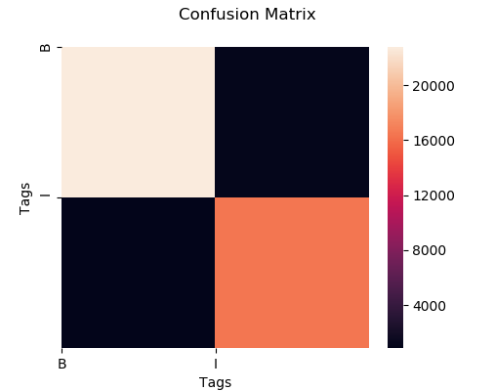
Using CRF for chunking
Tag-score | Precision | Recall | F1-score
Overall | 95.27 | 95.26 | 95.27
B | 96.3 | 95.5 | 95.9
I | 93.9 | 94.9 | 94.4
W_{i} , W_{i-1} , W_{i-2}
Word features like is_upper, is_title, is_digit
Word suffixes i.e. last 3 and last 2 letters
Pos_{i} , Pos_{i-1} , Pos_{i-2}
Is_first_word, is_second_word
Features Used

Slide 5
Error analysis MEMM
Misclassification of Conjunctions: Conjunctions take both O and I tags depending on context:
Many streets and_I sidewalks buckled, and_O subterranean water mains and_I service connections ruptured.
VBZ: Misclassification of B and I tags following VBZ: Words which have tags VBZ tend to be the beginners of Verb Phrase like for instance:
He has_VBZ_B given_VBN_I the exam.
But in some cases it also behaves like a verb indicating possession:
He has_VBZ_B options_NNS_I to choose from.
Our classifier tends to this as case when, especially when VERBS are used as a NOUN. For example:
H. Anthony Ittleson was elected a director of this company, which primarily has_VBZ_B interests_NNS_B in radio …...
Verb-Noun Confusion:
Pre-refunded bonds are called at their earliest call date with the escrowed proceeds of another bond issue.
Here “escrowed” is VBN_I and “proceeds” is NNS_I, but parser assigns B tag to “proceeds” thinking it as a VERB

Slide 6
Error analysis Bilstm
To+infinitive: Like POS system, chunking also suffers from this ambiguity problem and almost never predicts ‘to’ and ‘<verb>’ in the same chunk.
Sent: 'People tend to be mos' oov to brands that have oov oov , such as oov and oov .'
POS: ‘NNS VBP TO VB RBS JJ TO NNS WDT VBP JJ NNS , JJ IN NNS CC NN .'
Prediction: 'B B B I B I B B B B B I O B I B I B O’
Target: 'B B I I B I B B B B B I O B I B I I O’

